Slide 1
Vector Consolidation
Is it worth moving memory to consolidate like agents?

Slide 2
“USERID”
U
S
E
R
I
D
unborn
susceptible
exposed
infectious
recovered
deceased
Notes:
For the moment, assume that we need access to the properties of the deceased at the end of the simulation for validation and reporting purposes.
We will allocate space for the unborn and the deceased at initialization, so SEIR becomes USEIRD. By default U’s become S’s which is trivial, so U’s go at the front by the Ss. D’s only increase, so we will put them at the end so we only manipulate the start index for the D’s.
USEIRD pronounced “user id”

Slide 3
Contiguous Arrays
U₀ | … | U_{i-1} | U_{i} | S₀ | S₁ | … | S? | … | S_{j-1} | S_{j} | E₀ | E₁ | … | E_{k} | I₀ | … | I_{l} | R₀ | … | R_{m} | D₀ | … | D_{n}
⇡ |  |  | ⇡ | ⇡ |  |  |  |  |  | ⇡ | ⇡ |  |  | ⇡ | ⇡ |  | ⇡ | ⇡ |  | ⇡ | ⇡ |  | ⇡
c = Community(…)
c.add_group(“infectious”) # track start and end indices for “infectious”
c.add_property(“itimer”) # c._itimer = np.array(count)
…
c.infectious.itimer # c._itimer[infectious_{start}:infectious_{end}]
def update_infections(c): for index in range(len(c.infectious)):
c.infectious.itimer[index] -= 1
if c.infectious.itimer[index] == 0
c.move(c.infectious, index, c.recovered)
Notes:
We can dynamically create properties on the community object.

Slide 4
Moving Agents: births
U₀ | … | U_{i-1} | U_{i} | S₀ | S₁ | … | S? | … | S_{j-1} | S_{j} | E₀ | E₁ | … | E_{k} | I₀ | … | I_{l} | R₀ | … | R_{m} | D₀ | … | D_{n}
⇡ |  |  | ⇡ | ⇡ |  |  |  |  |  | ⇡ | ⇡ |  |  | ⇡ | ⇡ |  | ⇡ | ⇡ |  | ⇡ | ⇡ |  | ⇡
birth
U₀ | … | U_{i-1} | S₊ | S₀ | S₁ | … | S? | … | S_{j-1} | S_{j} | E₀ | E₁ | … | E_{k} | I₀ | … | I_{l} | R₀ | … | R_{m} | D₀ | … | D_{n}
⇡ |  | ⇡ | ⇡ |  |  |  |  |  |  | ⇡ | ⇡ |  |  | ⇡ | ⇡ |  | ⇡ | ⇡ |  | ⇡ | ⇡ |  | ⇡
Notes:
Births are easy: decrement the end pointer of U’s and start pointer of S’s and initialize the agent at that index.

Slide 5
Moving Agents: transmission
transmission
U₀ | … | U_{i-1} | S₊ | S₀ | S₁ | … | S? | … | S_{j-1} | S_{j} | E₀ | E₁ | … | E_{k} | I₀ | … | I_{l} | R₀ | … | R_{m} | D₀ | … | D_{n}
⇡ |  | ⇡ | ⇡ |  |  |  |  |  |  | ⇡ | ⇡ |  |  | ⇡ | ⇡ |  | ⇡ | ⇡ |  | ⇡ | ⇡ |  | ⇡
U₀ | … | U_{i-1} | S₊ | S₀ | S₁ | … | S_{j} | … | S_{j-1} | E₊ | E₀ | E₁ | … | E_{k} | I₀ | … | I_{l} | R₀ | … | R_{m} | D₀ | … | D_{n}
⇡ |  | ⇡ | ⇡ |  |  |  |  |  | ⇡ | ⇡ |  |  |  | ⇡ | ⇡ |  | ⇡ | ⇡ |  | ⇡ | ⇡ |  | ⇡
Notes:
Moving from S to E, E to I, I to R, and R to D (neighboring groups) is straightforward:
- swap the values of the last agent in the source group with the moving agent (if not the same)
- decrement the end index of the source group and the start index of the destination group.

Slide 6
Moving Agents: deaths
U₀ | … | U_{i-1} | U_{i} | S₀ | S₁ | … | S? | … | S_{j-1} | S_{j} | E₀ | E₁ | … | E_{k} | I₀ | … | I_{l} | R₀ | … | R_{m} | D₀ | … | D_{n}
⇡ |  |  | ⇡ | ⇡ |  |  |  |  |  | ⇡ | ⇡ |  |  | ⇡ | ⇡ |  | ⇡ | ⇡ |  | ⇡ | ⇡ |  | ⇡
S ➟ E ➟ I ➟ R ➟ D 🫤
Notes:
Deaths from S, E, or I are a hassle, we must serially move the agent from the starting group through the intervening groups until we get to the D’s.

Slide 7
Pure Python 🫤
def movei(self, source: int, index: int, target: int):
isource, iswap = self.igroups[source, :]
isource += index
if isource != iswap:
for array in self.attributes: #  this!
array[iswap], array[isource] = array[isource], array[iswap]
self.igroups[source, _LAST] -= 1
self.igroups[target, _FIRST] -= 1
Notes:
We would like to Numba-fy or otherwise compile the move() function, but it needs access to the list of attributes to know what to move.
This is a solvable problem; we can gather the addresses (and sizes) of the various attributes to pass down to a compiled function.

Slide 8
Index Management
def update_exposures(c, inf_mean, inf_std):
# start from the end and work forward because move()
# will be changing the end index of the group
for index in range(len(c.exposed) - 1, -1, -1):
timer = c.exposed.etimer[index] - 1
c.exposed.etimer[index] = timer
if timer == 0:
# update itimers before the move because index
# will not be valid after the move
c.exposed.itimers[index] = random.normal(inf_mean, inf_std)
c.move(c.exposed, index, c.infectious)
Notes:
Index management is a hassle. As we update agents, we may move them to another group. This puts a different agent into the current slot so we cannot use for index in range(len(group)) or we would move an unexamined agent into the current slot and then proceed – skipping processing on the new occupant of the current slot.
This is not rocket science, but it is an opportunity for bugs.

Slide 9
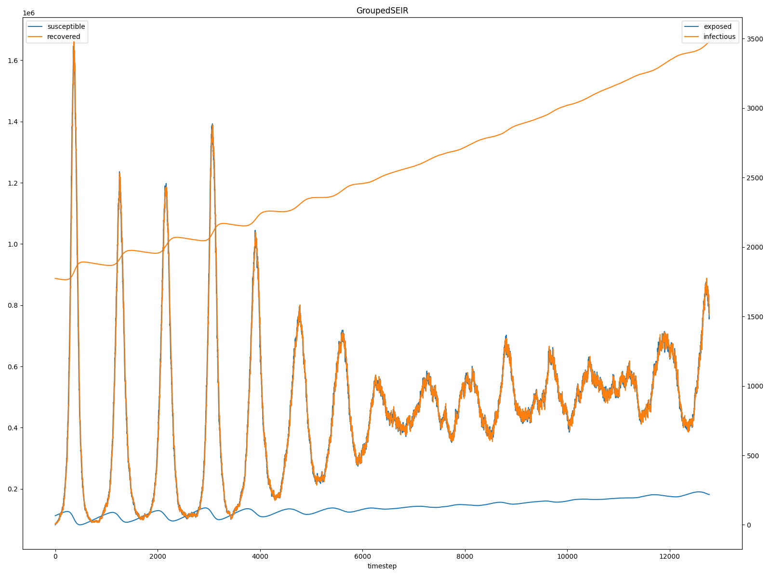
Performance – 35 years, 10⁶ initial agents
consolidate.py -t 12775 -p 1000000 --exp_mean 8 --exp_std 2 --inf_mean 8 --inf_std 1 --r_naught 10 --filename measles2050.csv
elapsed time: 0:00:56.5
Notes:
This isn’t too bad considering it doesn’t use Numba or more than one core.

Slide 10
Sample Output
timestep | elapsed | unborn | susceptible | exposed | infectious | recovered | deceased | births | deaths
0 | 0 | 1950404 | 112500 | 0 | 10 | 887490 | 0 | 0 | 0
1 | 14 | 1950322 | 112577 | 1 | 10 | 887461 | 33 | 82 | 33
2 | 14 | 1950243 | 112653 | 1 | 10 | 887420 | 77 | 79 | 44
3 | 13 | 1950164 | 112726 | 3 | 10 | 887378 | 123 | 79 | 46
4 | 15 | 1950083 | 112803 | 4 | 10 | 887349 | 155 | 81 | 32
5 | 14 | 1950004 | 112877 | 6 | 10 | 887314 | 193 | 79 | 38
6 | 14 | 1949943 | 112930 | 8 | 9 | 887292 | 222 | 61 | 29
7 | 12 | 1949863 | 113006 | 8 | 10 | 887266 | 251 | 80 | 29
8 | 14 | 1949771 | 113090 | 9 | 7 | 887239 | 288 | 92 | 37
9 | 13 | 1949675 | 113180 | 9 | 5 | 887214 | 321 | 96 | 33
⋮ | ⋮ | ⋮ | ⋮ | ⋮ | ⋮ | ⋮ | ⋮ | ⋮ | ⋮
12766 | 30 | 502961 | 181990 | 1569 | 1650 | 1659504 | 602730 | 151 | 57
12767 | 30 | 502825 | 181927 | 1559 | 1621 | 1659687 | 602785 | 136 | 55
12768 | 30 | 502668 | 181887 | 1533 | 1652 | 1659831 | 602833 | 157 | 48
12769 | 28 | 502506 | 181848 | 1547 | 1612 | 1659992 | 602899 | 162 | 66
12770 | 28 | 502355 | 181809 | 1529 | 1577 | 1660175 | 602959 | 151 | 60
12771 | 28 | 502212 | 181736 | 1536 | 1587 | 1660316 | 603017 | 143 | 58
12772 | 28 | 502052 | 181730 | 1501 | 1582 | 1660451 | 603088 | 160 | 71
12773 | 28 | 501888 | 181724 | 1481 | 1579 | 1660584 | 603148 | 164 | 60
12774 | 28 | 501733 | 181672 | 1495 | 1560 | 1660741 | 603203 | 155 | 55
12775 | 30 | 501576 | 181648 | 1491 | 1516 | 1660902 | 603271 | 157 | 68
Notes:
Note that we waste quite a bit of space (500k agents) to make sure we have enough to deal with stochasticity in the birth/death process.
IIRC, processing time, e.g. 30ms for the final timestep, is at this point dominated by dealing with deaths and interring deceased agents (moving them to the D group).

